Slide 1

Ruby Programming Language

Slide 2
INTRODUCTION:
Ruby is a scripting language designed by Yukihiro Matsumoto, also known as Matz.
It runs on a variety of platforms, such as Windows, Mac OS, and the various versions of UNIX.

Slide 3
FEATURES:
Ruby is an open-source and is freely available on the Web, but it is subject to a license.
Ruby is a general-purpose, interpreted programming language.
Ruby is a true object-oriented programming language.
Ruby is a server-side scripting language similar to Python and PERL.
Ruby can be used to write Common Gateway Interface (CGI) scripts.
Ruby can be embedded into Hypertext Markup Language (HTML).
Ruby has a clean and easy syntax that allows a new developer to learn very quickly and easily.
Ruby can easily be connected to DB2, MySQL, Oracle, and Sybase.
Ruby has a rich set of built-in functions, which can be used directly into Ruby scripts.

Slide 4
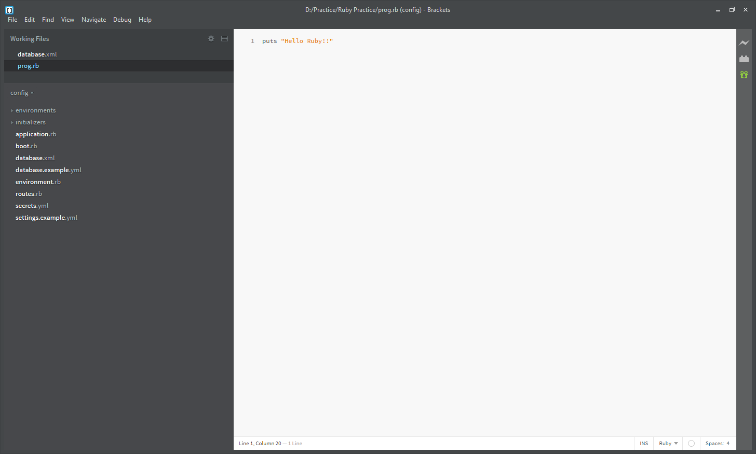
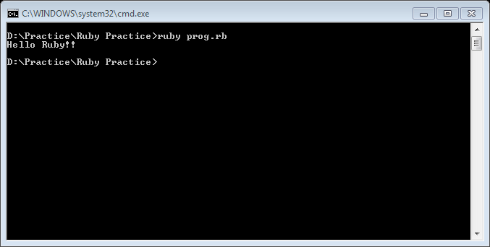
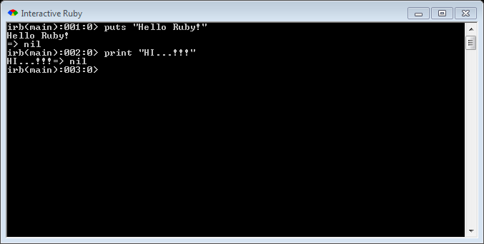
How to run your Ruby file?
Method 1:
Method 2:

Slide 5
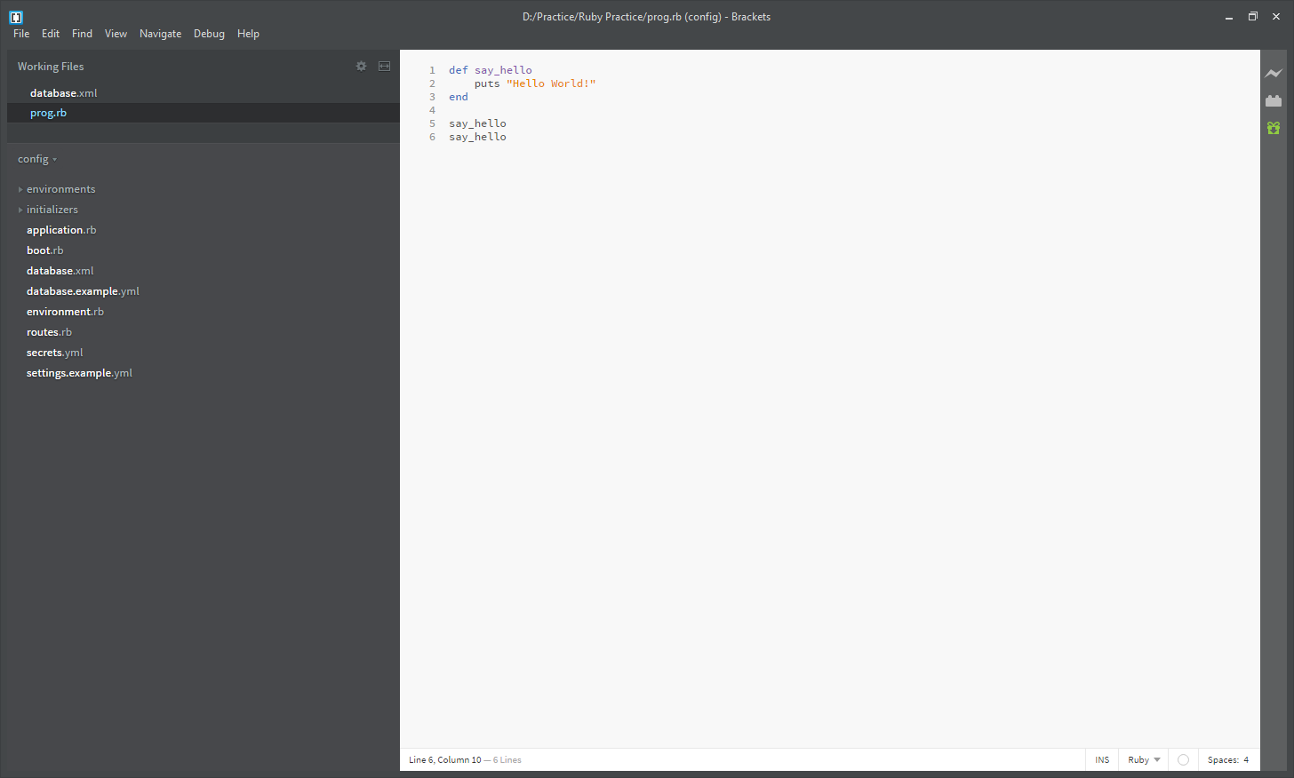
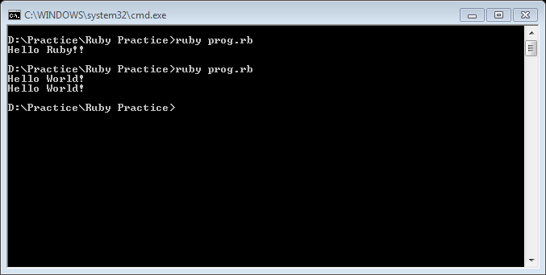
Ruby does not have a main method like Java
Just write your code directly in a file
Ruby statements do not end with semicolons
Method calls don’t need parenthesis

Slide 6
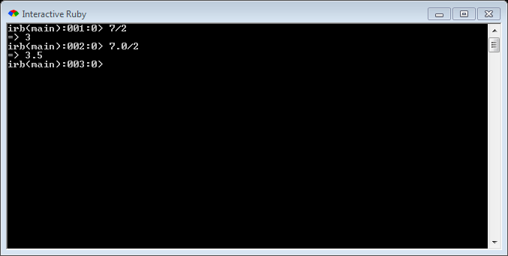
Expressions:
Arithmetic is similar to Java
Operators similar to Java
+ - * / % (plus ** for exponentiation)
Precedence
() before ** before * / % before + -
Integers vs Real Numbers

Slide 7
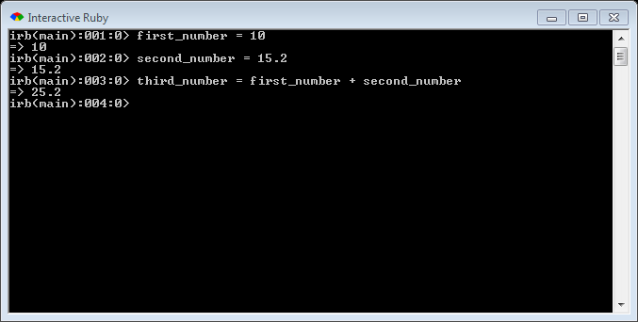
DATA TYPES:
NUMBERS:
Ruby can handle both integers and floating point numbers (numbers with decimals), and it does it just how you would expect.

Slide 8
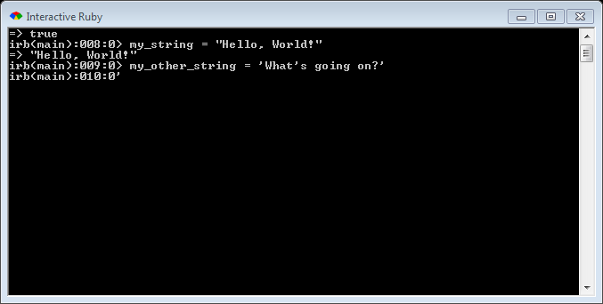

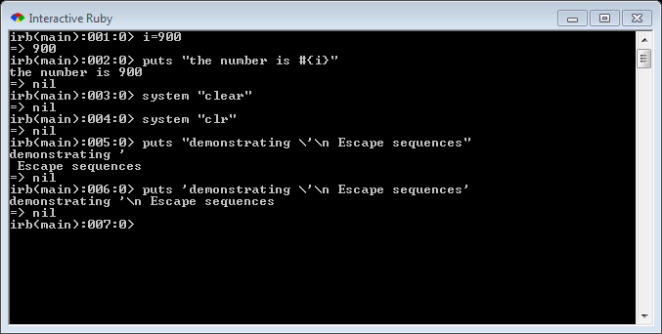
STRINGS:
Ruby strings aren't much different from other languages you're probably used to. You can use both double quotes and single quotes to create strings:
“ ” allows escape sequences
‘ ’ does not allow escapes (except for \’)

Slide 9
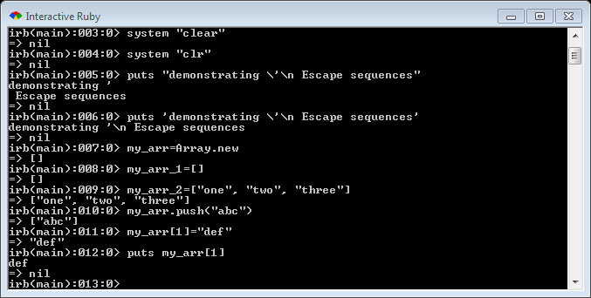
ARRAYS:
There are two ways to create an empty array.
To add an item to an array, you can use the push method, or use square-bracket notation, putting the appropriate index in the brackets. You can use square brackets to get the values back, as well.
In Ruby, we can also mix types in an array.

Slide 10
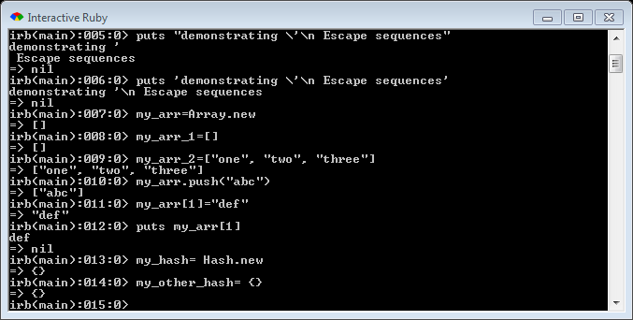
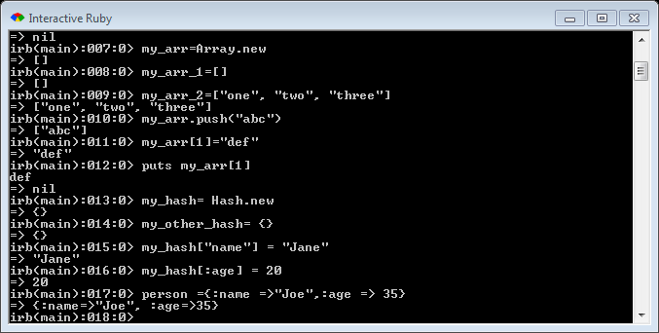
HASH:
A hash in Ruby is like an object literal in JavaScript or an associative array in PHP. They're made similarly to arrays:
To put item in a hash, you again use the square-bracket notation. You can use any value as the key, but strings, or symbols (coming up next) are common options.
To create a hash with objects in it right from the beginning, you use a notation almost identical to JavaScript's object literals; the only difference is that Ruby uses an arrow (=>) between keys and values:

Slide 11
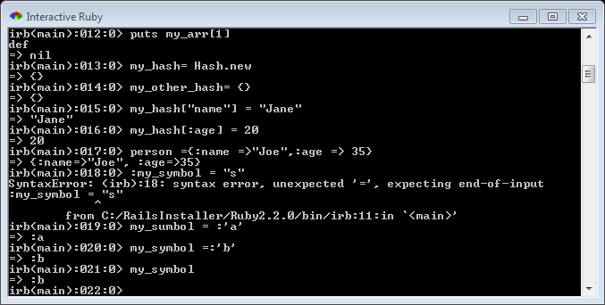
SYMBOLS
Symbols are light-weight strings. They're often used as identifiers, in places other languages would often use strings. They're used instead of strings because they can take up much less memory
TRUE, FALSE & NIL
These values work just as you'd expect them to. Nil is Ruby's "nothing" value,
although it is an object.

Slide 12

Variables/Types
Don’t declare types
Ruby is looser about Types than Java
Type of variable can change throughout program

Slide 13

String Multiplication
Strings can be multiplied by integers
Concatenates string repeatedly

Slide 14
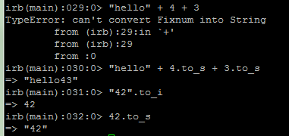
Strings and Ints
Integers and Strings cannot be concatenated in Ruby
to_s – converts to string
to_i – converts to integer

Slide 15


Loops
The for loop
Java
Ruby

Slide 16



Loops
The while loop
Java
Ruby

Slide 17

Constants
Ruby doesn’t really have constants
Instead declare a variable at the top of your code and it will be accessible everywhere
You will get a warning if you change a constant, but you can change it anyway (bad style)

Slide 18

Parameters
Parameters are declared by writing their names (no types)
May seem odd that we can pass ints, strings, or arrays

Slide 19
Duck Typing
Actually, we can pass anything that has a + method
This is called Duck Typing
This allows us to write flexible, reusable code

Slide 20

Inspecting Objects
How do I know whether an object has a + method?
You can ask the object (with the “methods” method)
Everything is an object in Ruby (no primatives)

Slide 21
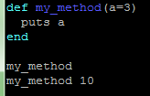

Default Parameter Values
You can give a default value to parameters
The caller doesn’t have to pass a value

Slide 22
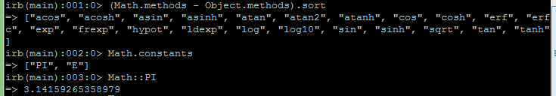
Math
The Math module has methods and constants that you can use
Has many of the same methods as Java

Slide 23
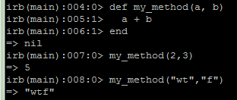

Returning Values
Methods in Ruby return the last value evaluated (only do this if you’re an expert)
You can also explicitly return values, and this is less error prone

Slide 24


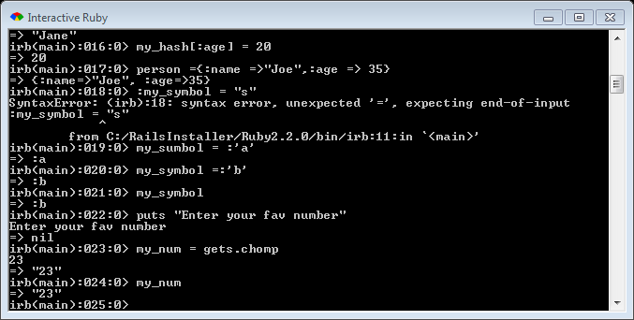
Reading from the Console
Java
Ruby

Slide 25

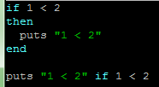
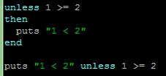
If Statements
Java
Ruby

Slide 26
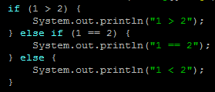
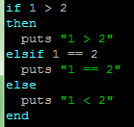
elsif
Java
Ruby

Slide 27

Logical Operators
== != >= <= < > (just like Java)
<=> (not in Java)
Remember, because of Duck Typing these are applicable to more than just numbers
&& || ! (just like Java)

Slide 28
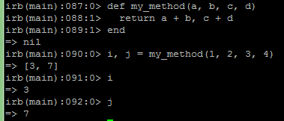
Multiple Assignment
Can assign to and return multiple items at a time (uses arrays under the covers)

Slide 29
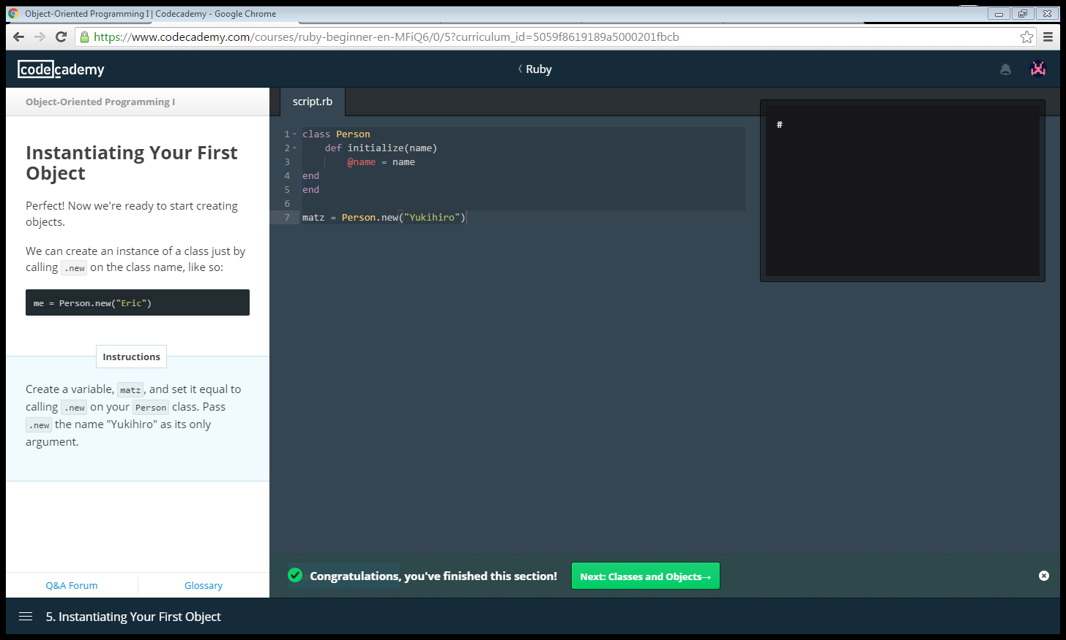
Classes:
Ruby is an object-oriented programming language, which means it manipulates programming constructs called objects.
A class is just a way of organizing and producing objects with similar attributes and methods.

Slide 30
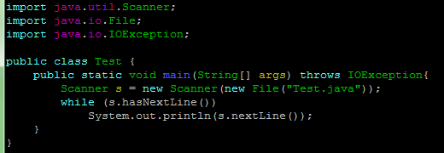

Reading Files
Java
Ruby

Slide 31
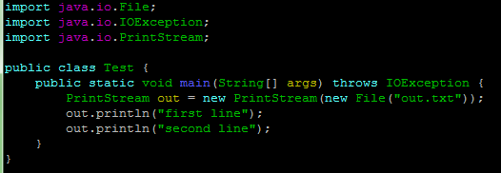
Writing Files
Java
Ruby

Slide 32
THANK YOU

